Slide 1
Transfer Students at
Appalachian State University
Heather Langdon, Institutional Research, Assessment, and Planning (IRAP)
Phil Lewis, Jump Start Appalachian
September 2013

Slide 2
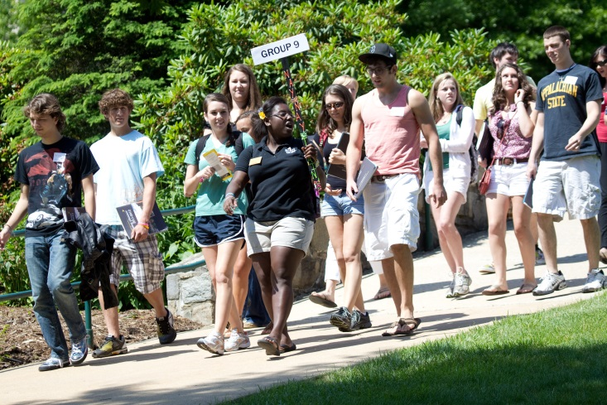

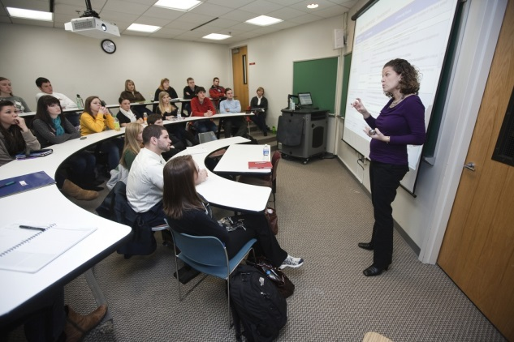
Who Are Our Transfer Students?

Slide 3
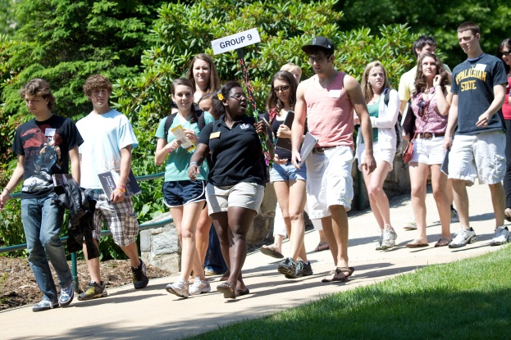
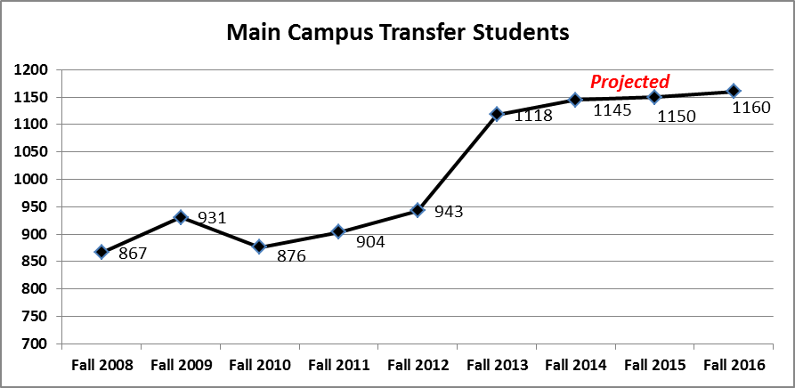
Who Are Our
Transfer Students?
How many do we have?

Slide 4
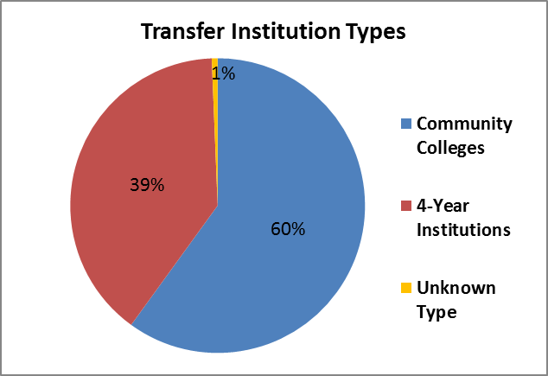
Who Are Our Transfer Students?
Where do they come from?

Slide 5
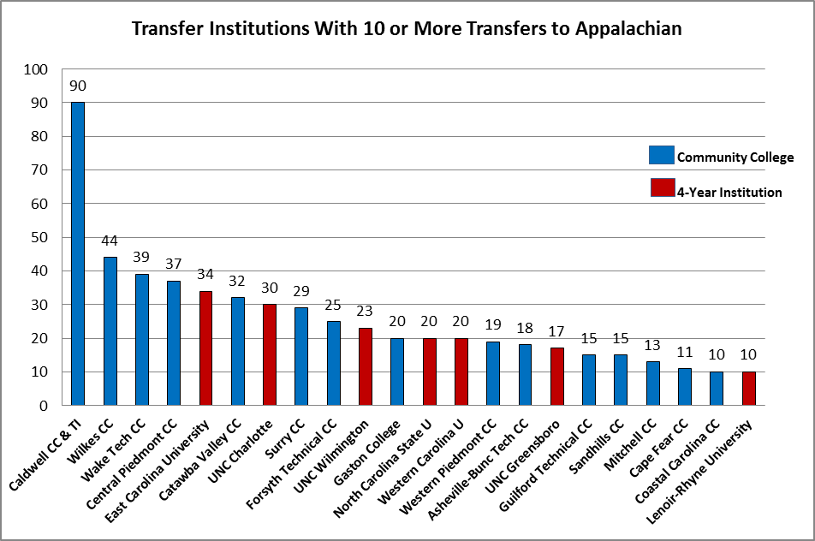
Who Are Our Transfer Students?
Where do they come from?

Slide 6
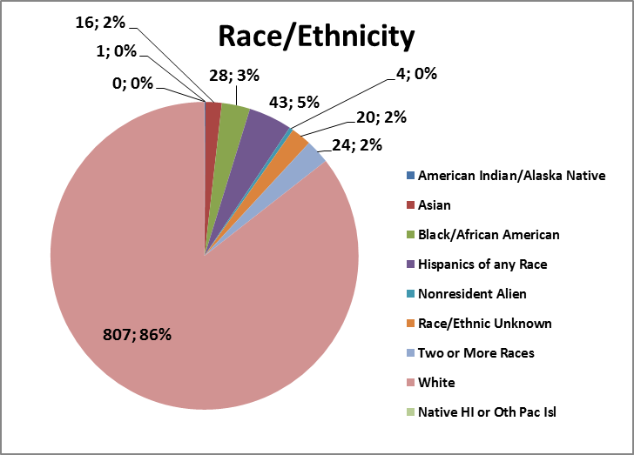
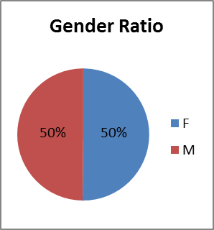
Who Are Our Transfer Students?
Who are they?

Slide 7
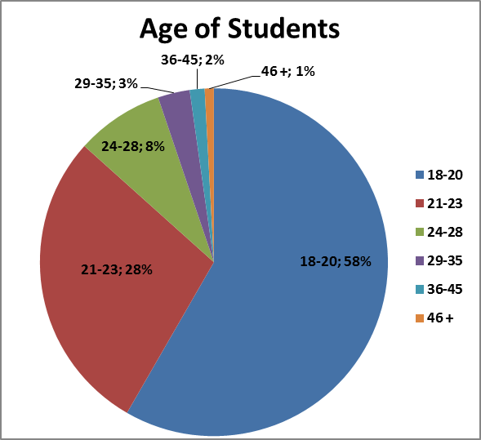
Who Are Our Transfer Students?
Who are they?
Average age: 21.5

Slide 8
Who Are Our Transfer Students?
What do they bring?
Fall 2012 New Transfer Student Cohort
20% Enrolled with Gen Ed/Core Met
205 (22%) enrolled with Associate’s degree completed
Average Number of Credits Transferred: 50 Credit Hours
Credit Ranges
  64% Transferred 59 Credit Hours or Less
  36% Transferred 60 Credit Hours or More

Slide 9

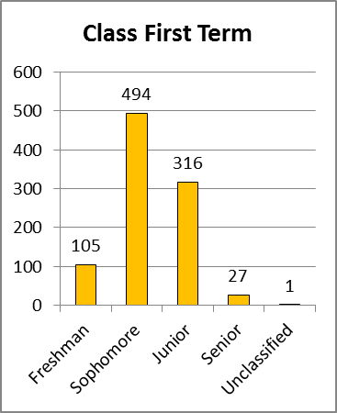
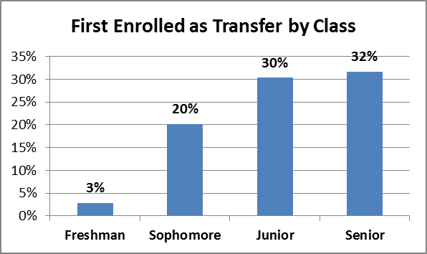
Who Are Our
Transfer Students?
What is their academic standing?

Slide 10
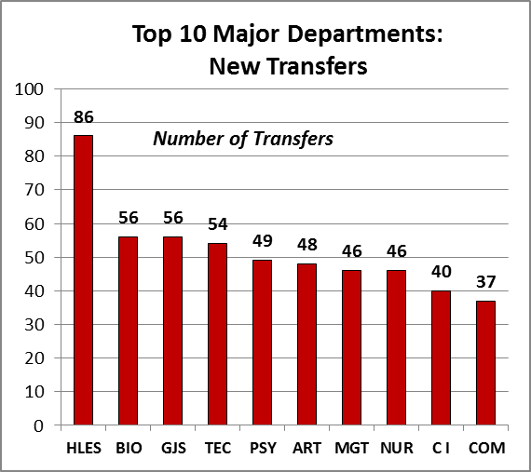
Who Are Our
Transfer Students?
Which majors do they choose?

Slide 11
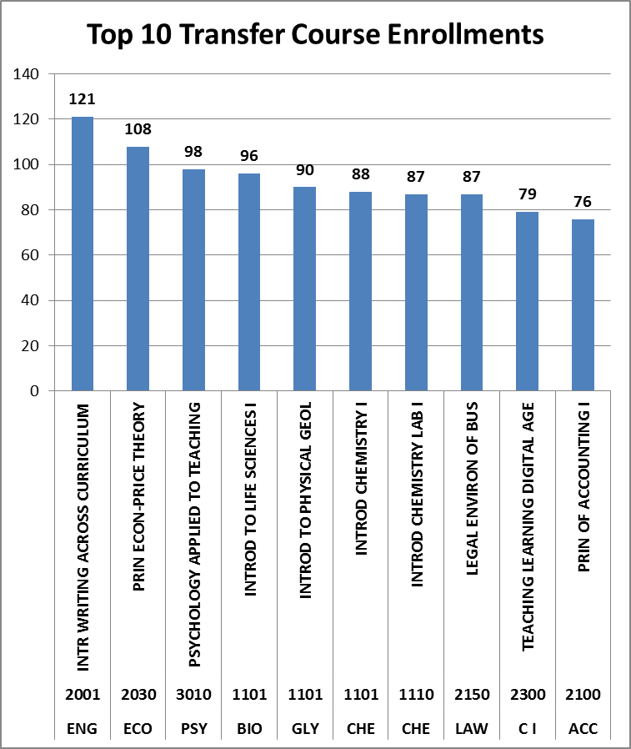
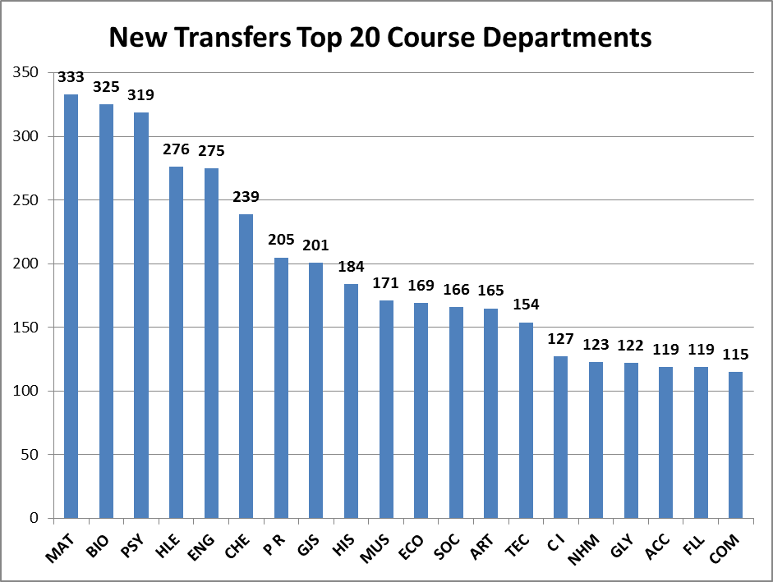
Who Are Our
Transfer Students?
How many are in my classes?

Slide 12

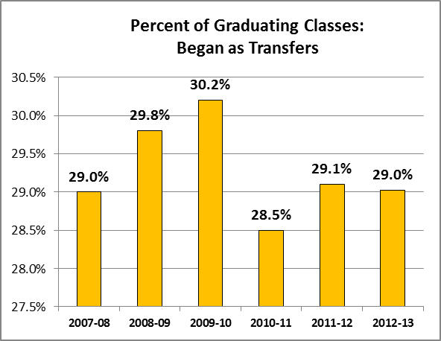
Who Are Our
Transfer Students?
How many graduate?
Average Time to Degree:
2.6 Years

Slide 13
Who Are Our
Transfer Students?
How many graduate?

Slide 14
What Do They Tell Us?
MAP-Works Surveys
Fall Transition Survey Positive Ratings (7 Point Scale)
Commitment to, and Satisfaction with, Appalachian
Self Assessments of Academic Behaviors
Living Environment (Off-campus) (On-campus not assessed)

Slide 15
What Do They Tell Us?
MAP-Works Surveys
Fall Transition Survey Negative Ratings
Homesickness “Distressed”
Financial Means
Peer Connections
Social Integration

Slide 16
What Do They Tell Us?
Graduating Senior Survey
High satisfaction with their ASU education (95%)
High satisfaction with faculty interactions (93%)
NSSE
Did not work with faculty on activities other than coursework (49%)

Slide 17
What Do They Tell Us?
Come to the Student Panel later today!

Slide 18
Who Are Our Transfer Students?
For More Information
Transfer Symposium Tool-Kit
http://transfersymposium.appstate.edu/tool-kit
Transfer Talking Points
http://irap.appstate.edu/institutional-research/reports-studies
Jump Start Appalachian
http://jumpstart.appstate.edu/

Slide 19
Table Discussion
What impressions do you have about this session?
How can you use the data/
what did you learn?
Are you aware of working with any transfer students last year?
Did transfer students you worked with have issues that would be helpful for us to know?

